Slide 1
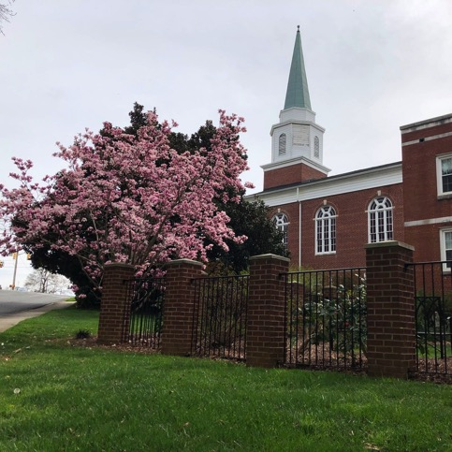
The State of the Church in
21st Century America
Oakland Baptist Church
January 9, 2022
Bill Wilson

Slide 2

A healthy church is a community of Jesus followers with shared vision,
thriving ministry and
trusted leadership.
www.chchurches.org

Slide 3
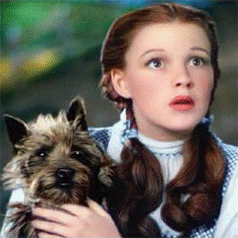
“Toto, I have a feeling we’re not in Kansas anymore.”

Slide 4
The State of the Church in the 21st Century
Every truth passes through three stages before it is recognized.
In the first, it is ridiculed.
In the second, it is opposed.
In the third, it is regarded as self-evident.
Arthur Schopenhauer

Slide 5
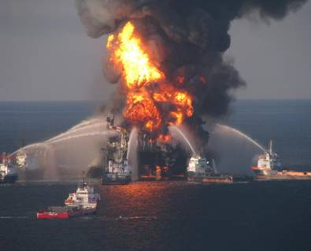
The Burning Platform Syndrome
JULY 6, 1988
Piper Alpha Platform off the coast of Scotland
Andy Mochan
He jumped “because he had to, not because he wanted to.”

Slide 6
The Burning Platform Syndrome
Personal and organizational change is often precipitated by a real or perceived “burning platform”. Change is usually pushed by discomfort with the status quo or unease about what is predicted if change is not made.

Slide 7
One last thought before we embark…
Numbers 13-14
“We came to the land to which you sent us; it flows with milk and honey, and this is its fruit. Yet the people who live in the land are strong, and the towns are fortified and very large…the land devours its inhabitants; and all the people we saw were of great size…to ourselves we seemed like grasshoppers, and so we seemed to them.”
So the people said: “Let us choose a captain, and go back to Egypt…”

Slide 8
The State of the Church
The percentage of people that attend a Christian Church on any given weekend is far below what pollsters report (40%-47%).
17%
Actual counts in Christian churches show that 17% of the population actually attended.
Source: The American Church Research Project, 2010. www.TheAmericanChurch.org

Slide 9
The State of the Church
The percentage of people that attend a Christian Church on any given weekend is far below what pollsters report (40%-47%).
15%
Actual counts in Christian churches show that 17% of the population actually attended.
Source: The American Church Research Project, 2010. www.TheAmericanChurch.org

Slide 10
Percent of the Population Attending Church on Any Given Weekend in 2009
Source: The American Church Research Project, 2010. www.TheAmericanChurch.org

Slide 11
Growth or Decline in the
Percentage of the Population
Attending a Christian Church from 2000 - 2009
-8.8%
WA
-11.7%
-9.4%
-14.2%
NH
-13.5%
MT
ND
-16.6%
ME
-15.2%
VT
OR
-21.1%
-12.0%
-14.9%
-13.1%
-20.7%
-16.2%
MA
ID
SD
MN
WI
NY
-21.4%
-15.2%
-8.4%
RI
WY
MI
-15.8%
-12.8%
-10.1%
-14.3%
CT
NE
IA
-10.3%
PA
-14.9%
-1.5%
-6.2%
-11.3%
-8.2%
OH
NJ
-10.3%
-5.9%
NV
UT
-10.0%
IL
IN
-11.7%
DE
CA
CO
-8.6%
WV
-6.2%
-8.3%
KS
-8.5%
-6.8%
VA
MD
MO
KY
-7.3%
-10.8%
-5.1%
TN
NC
-12.6%
-14.8%
OK
-2.6%
AZ
NM
AR
-6.5%
Decline
-9.3%
SC
Growth
-5.4%
-3.8%
GA
MS
AL
-10.7%
-12.3%
TX
LA
-14.2%
AK
-10.3%
FL
-4.3%
HI

Slide 12
The State of the Church
40 year+ churches are declining in attendance by 2 percent each year.
Once churches reach 40+ years of age, on average they decline.
- 2%
Source: The American Church Research Project, 2010. www.TheAmericanChurch.org

Slide 13
Growth Rate Based on Year Church was Started for 2007 to 2008
Source: The American Church Research Project, 2010. www.TheAmericanChurch.org

Slide 14
Growth Rate Based on Church Size for 2007 to 2008
Source: The American Church Research Project, 2010. www.TheAmericanChurch.org

Slide 15
Mega Church Facts
Hartfordinstitute.org “Not Who You Think They Are”
Mega Churches grow an average of 8% annually.
94% of that growth is biological/transfer growth. “Upgrade” growth. 75% of those attendees come from other churches.
Only 6% of MC attendees had never attended worship services before coming (5% at “all churches”)
18% had “not attended church in years” (16% at “all churches”)

Slide 16
Thom Rainer

Slide 17
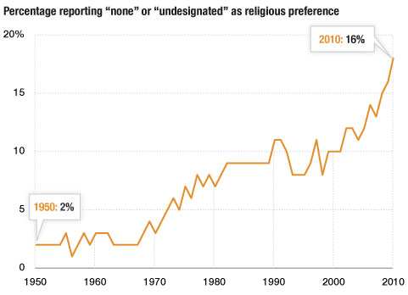
Source: Gallup
Credit: Matt Stiles/NPR

Slide 18
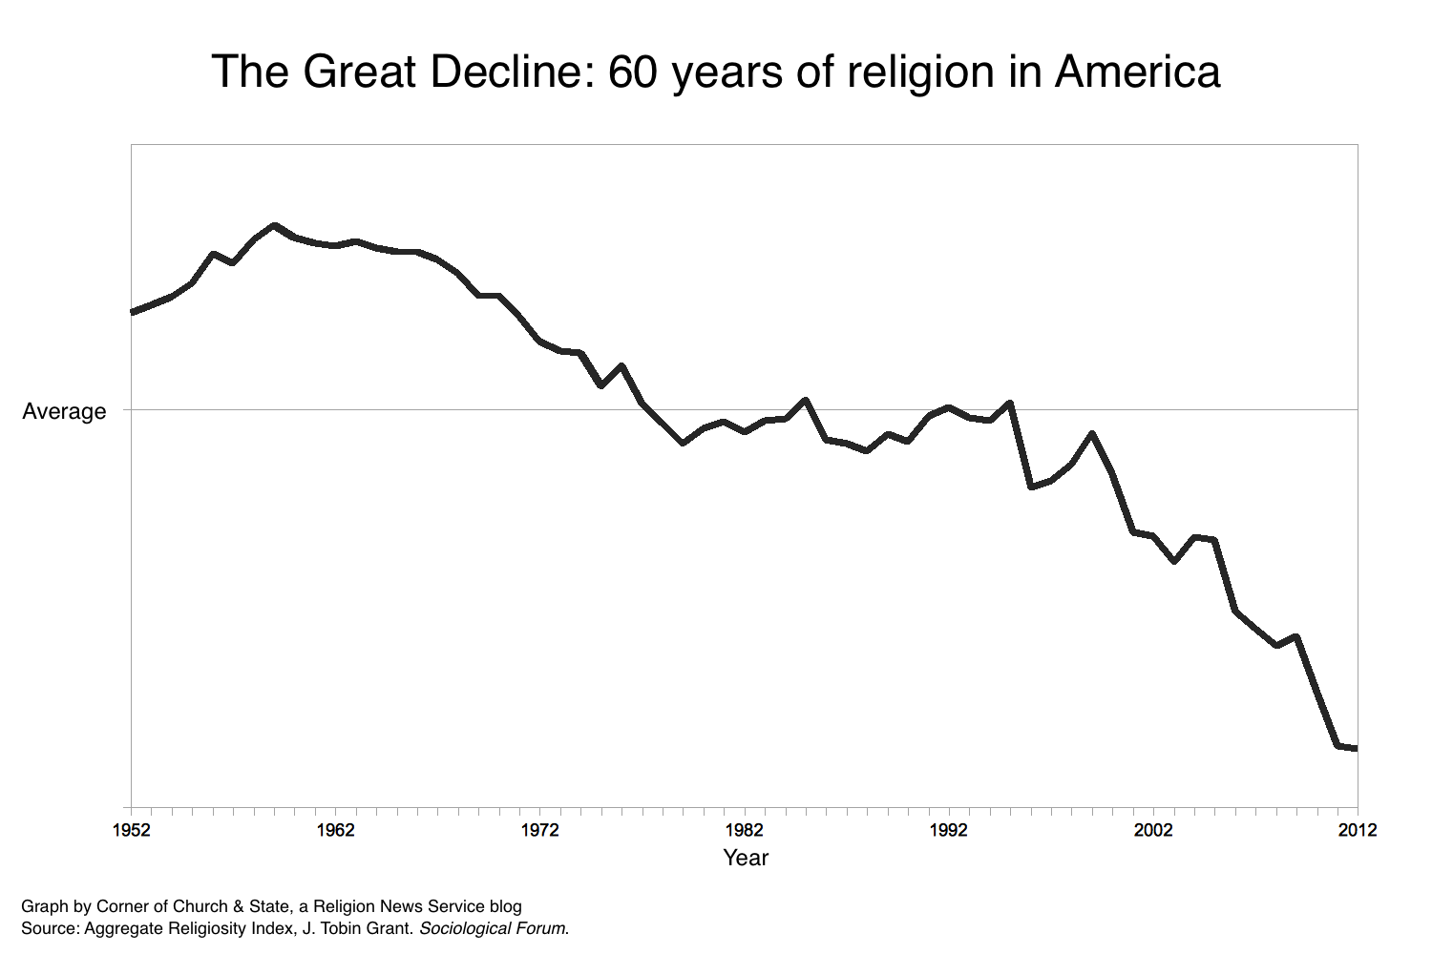
Tobin Grant-RNS

Slide 19
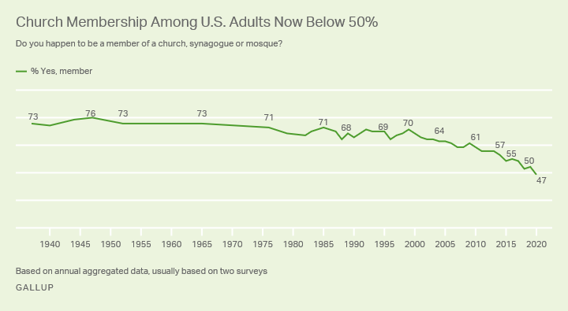

Slide 20
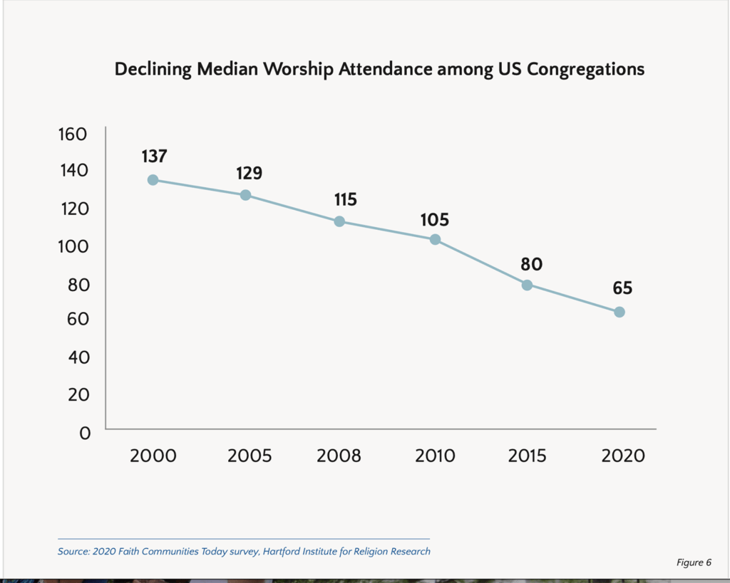

Slide 21
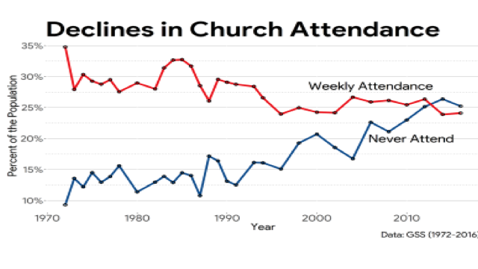

Slide 22
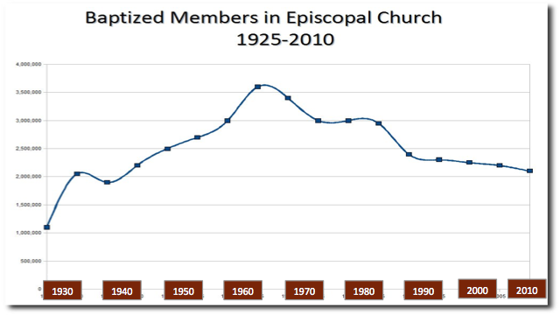

Slide 23
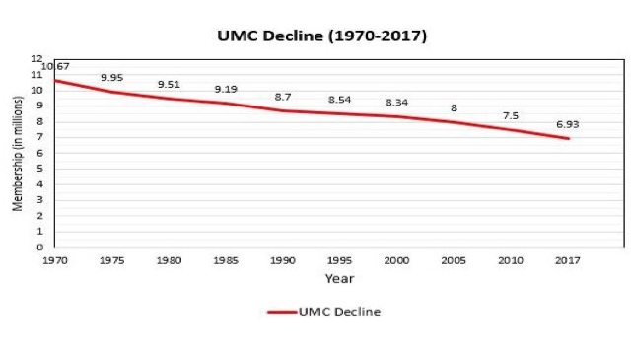

Slide 24
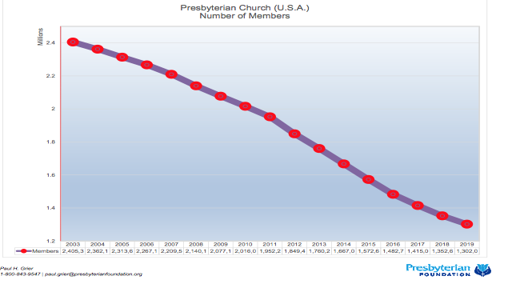

Slide 25
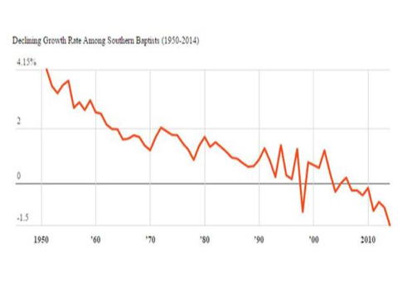

Slide 26
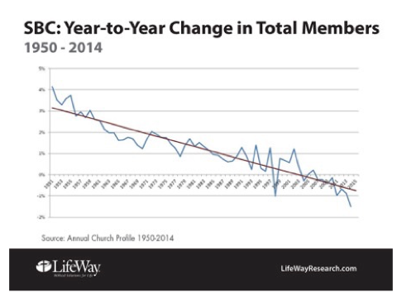

Slide 27
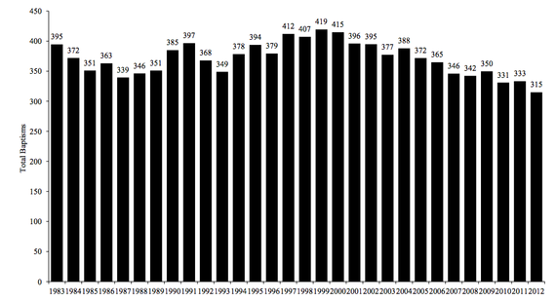
SOUTHERN BAPTIST BAPTISMS

Slide 28
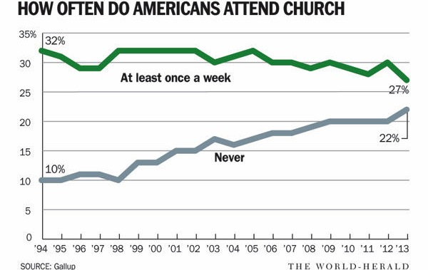

Slide 29
The Future of American Church Attendance Percentage if Nothing Changes
Source: The American Church Research Project, 2010. www.TheAmericanChurch.org

Slide 30
The issue of
Frequency of Attendance
Why it matters

Slide 31



500 active members
3x per month
375 average attendance
2x per month
250 average attendance
1x per month
125 average attendance

Slide 32
Why frequency is dropping
Youth sports leagues, competitions of all kinds
Vacation homes, timeshares
Collegiate and professional athletics/events
The dramatic increase in the number of “holiday” weekends
Illness (as people live longer, they are more likely to be seriously ill and unable to attend)
Aging parents
Exhaustion
Ease of travel
Work
Commitment level

Slide 33
What does this mean to us??
1/3 of the American work force is at work on Sunday morning.

Slide 34
Perilous times…
4,000 churches close their doors every year…2% per year. 1 in 4 will close by 2030. Some predict 1 in 3.
There are less than half of the number of churches today than there were only 100 years ago.
3,500 people leave the Church every day.
Since 1950, there are 1/3rd fewer churches in the U.S.

Slide 36

Putting it together
There is at least 40-60% of our population which attending the Sunday morning worship service model will not reach. We need to have churches that focus on this percentage and on the other percentage. Both are necessary.
Right now, most of our eggs are in one basket.

Slide 37
Are attractional metrics (nickels and noses) adequate for 2022?
“Adequate metrics for your church will reflect your understanding of the mission of Jesus”. Dave Ferguson, lead pastor at Community in Chicago
COUNTING or MEASURING?
Missional Church Metrics:
Reach Impact
Restore Renew
Reproduce

Slide 38
Thriving churches…
Embrace a “mixed economy” of methods
  ATTRACTIONAL
  ENGAGED
  INCARNATIONAL
Live in a balance between “attractional” church and “missional church”
Leadership is catalytic, visionary, passionate
Manage both EXTERNAL and INTERNAL focus
Acknowledge we live in Post-Christendom
Embrace entrepreneurial thinking/methods

Slide 39



Slide 40
Option #1

Slide 41

Option #2

Slide 42
Option #3

Slide 43

3 characteristics of churches reaching their community
Strong mission focus
Willingness to re-imagine church
Commitment to both existing and new forms of church
Coffeehouse
Messy Church
Running Club
Single Moms
Neighborhood
Notes:
Three characteristics:
a strong mission focus;
a willingness to re-imagine church so that people can encounter Christ in their culture;
a commitment to the mixed economy of existing and new forms of church.
Share: What is a fresh expression of church? sharetheguide.org/section1/1

Slide 44
What’s Up For Change?
Day & Time
Who leads
Parish & Place
Style of Public Meeting
Group Size
Basis of Membership / Commitment
Priority of Worship
Notes:
What’s going on?
All around the country:
Emphasise that this is happening in all places and in all kinds of areas – rural, suburban, and not just where there are ‘lively’ churches.
Point out that there are some in this area too and we will be hearing about those later.
God’s Spirit is on the move – emphasise that this is a movement of God not another strategy;
Christians are trying new things – the range here is immense as the DVD they are about to see will show;
New types of churches are being formed – they are real churches – they look and feel very different but they are real;
Fresh Expressions is helping with training and resources – and there is a national initiative set up to encourage fresh expressions of church and particularly to help with training and resources.
Share: What is a fresh expression of church? sharetheguide.org/section1/1

Slide 45
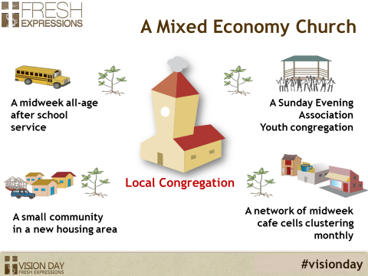
When Gathered AND Scattered work together…

Slide 46
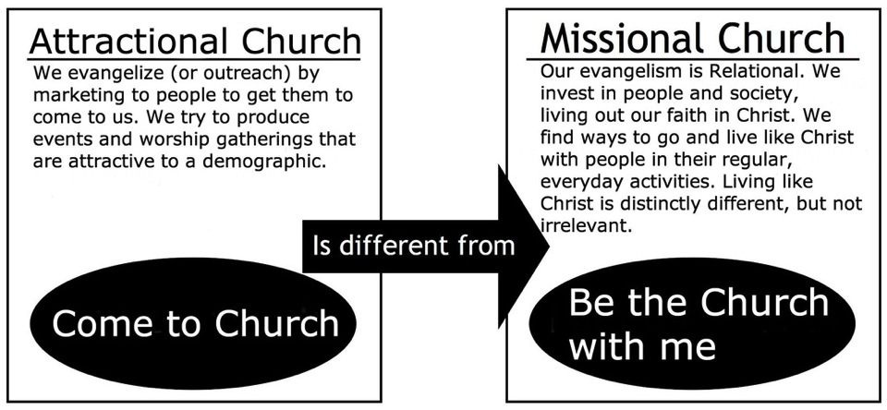
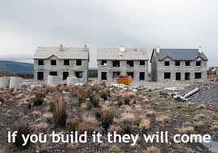
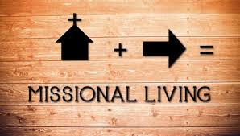
Models
Attractional (Gathered)
Missional (Scattered)

Slide 47

Either/Or
Both/And!!

Slide 48
Pandemic Lessons
What do these entities share in common?
  Higher Education
  Hospitals/Health Care
  Restaurants
  Movie Theaters
  Churches
  THEY:
  -Are atractional, geographic
  -Traditional
  -Optional
  -Meet an essential need
  -Adaptive
  -Etc.
  -

Slide 49
What lessons can we learn from others?

Slide 50
The Rest of the Story…
Joshua 1: 5 No one will be able to stand up against you all the days of your life. As I was with Moses, so I will be with you; I will never leave you nor forsake you. 6 "Be strong and courageous, because you will lead these people to inherit the land I swore to their forefathers to give them. 7 Be strong and very courageous. Be careful to obey all the law my servant Moses gave you; do not turn from it to the right or to the left, that you may be successful wherever you go. 8 Do not let this Book of the Law depart from your mouth; meditate on it day and night, so that you may be careful to do everything written in it. Then you will be prosperous and successful. 9 Have I not commanded you? Be strong and courageous. Do not be terrified; do not be discouraged, for the LORD your God will be with you wherever you go."

Slide 51
The Rest of the Story…
Joshua 2: 8 Before the spies lay down for the night, Rahab went up on the roof 9 and said to them, "I know that the LORD has given this land to you and that a great fear of you has fallen on us, so that all who live in this country are melting in fear because of you. 10 We have heard how the LORD dried up the water of the Red Sea for you when you came out of Egypt…11 When we heard of it, our hearts melted and everyone's courage failed because of you, for the LORD your God is God in heaven above and on the earth below.”

Slide 52
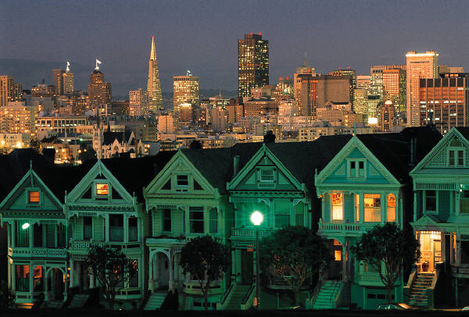
Jesus and the city
When he saw the crowds, he had compassion for them, because they were harassed and helpless, like sheep without a shepherd. Matthew 9:31
As he approached Jerusalem and saw the city, he wept over it…Luke 19:41

